Slide 1
Clustering, Dimensionality Reduction and Instance Based Learning
Geoff Hulten

Slide 2
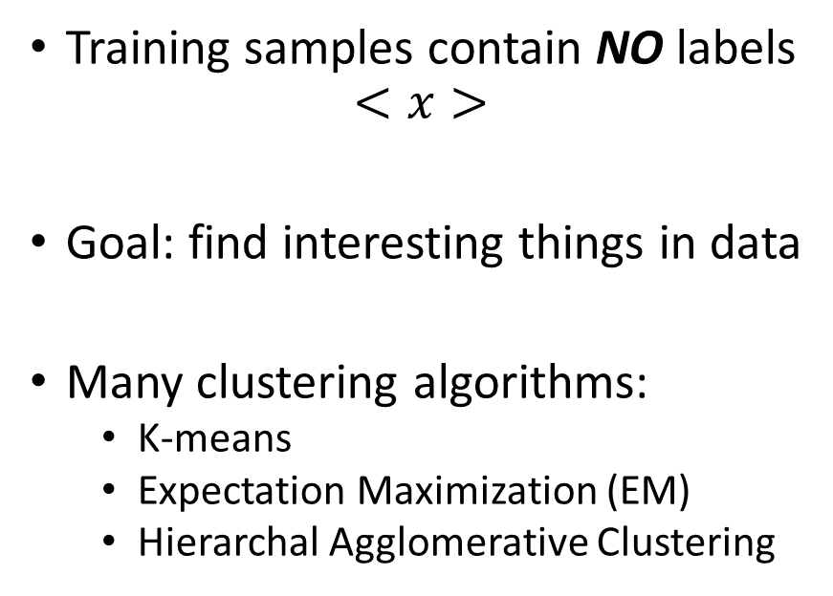
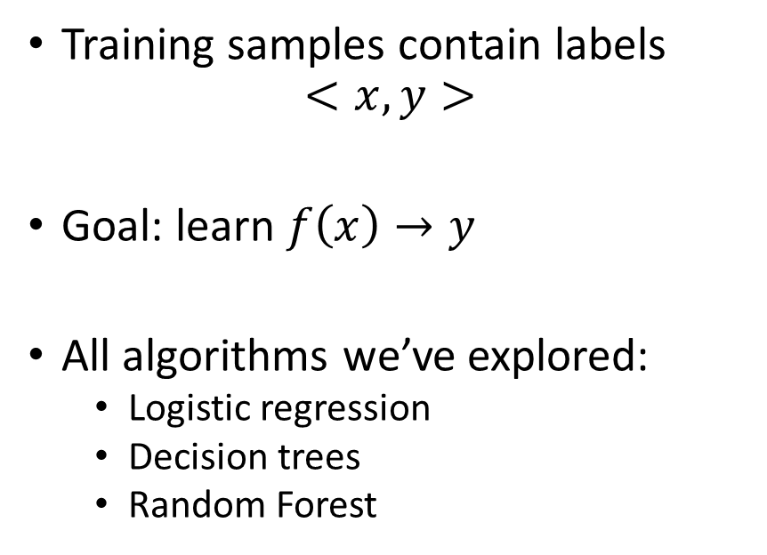
Supervised vs Unsupervised
Supervised
Unsupervised
Training samples contain labels
$$<x, y>$$
Goal: learn $f\left(x\right)→y$
All algorithms we’ve explored:
Logistic regression
Decision trees
Random Forest
Training samples contain NO labels
$$<x>$$
Goal: find interesting things in data
Many clustering algorithms:
K-means
Expectation Maximization (EM)
Hierarchal Agglomerative Clustering

Slide 3
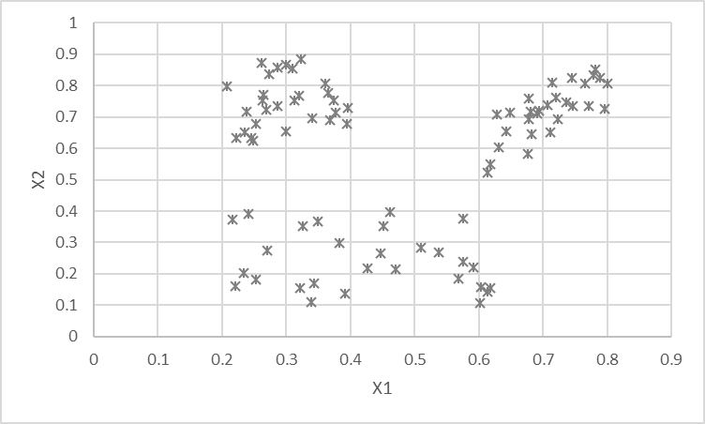
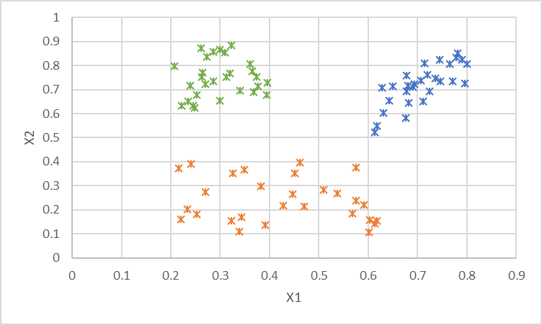
Example of Clustering
Why cluster?
Recommendation engines
Market segmentation
Search aggregation
Anomaly detection
Exploring your data
# of spammers
Processes generating data
Categories of mistakes

Slide 4
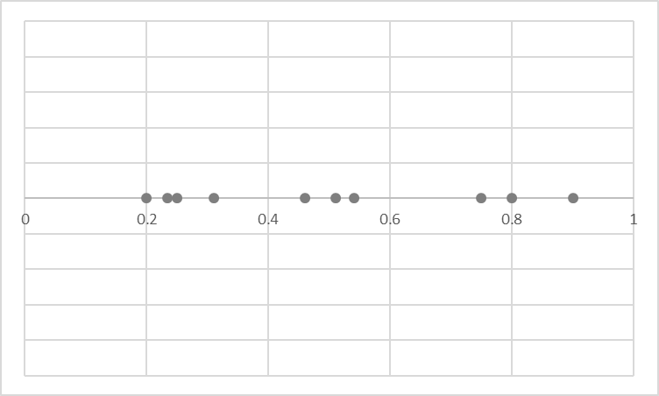
Some Important Types of Clustering
K-Means Cluster
Mixture of Gaussians
(Expectation Maximization)
Agglomerative Clustering
Cluster represented by a single point
Each point assigned to a cluster
Clusters placed to minimize avg distance between points and assigned clusters
Cluster represented by a gaussian
Each point has a probability of being generated by each cluster
Clusters placed to maximize likelihood of data
Hierarchical method
Each point is in a hierarchy of clusters
Each step combines nearest clusters into a larger cluster, cut where you want

Slide 5
K-Means Clustering – Model Structure
Structure – K cluster centroids
Loss – Average distance from sample to its assigned centroid
Optimization – Simple iterative process

Slide 6
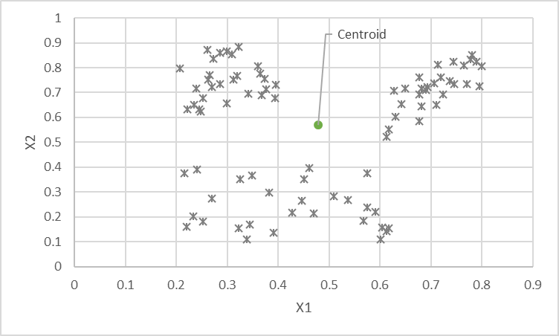
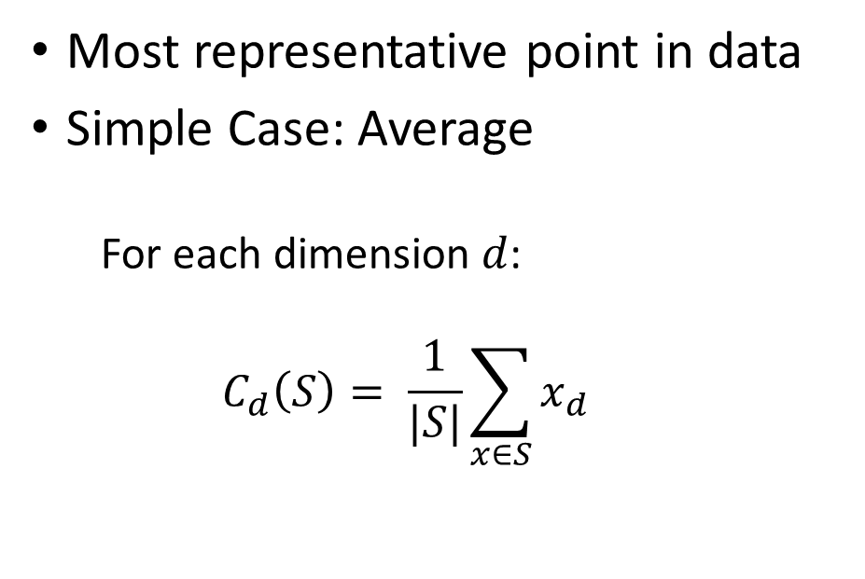
K-Means Clustering: The Centroid
Most representative point in data
Simple Case: Average
For each dimension $d$:
$$C_{d}\left(S\right)= \frac{1}{|S|}\sum_{x∈S}{x_{d}}$$

Slide 7







Distance Metrics (Loss) for K-Means
$$x$$
$$L^{n}\left(C_{x},x\right)= \sqrt[n]{\sum_{i=1}^{\#dim}{{|c_{i}− x_{i}|}^{n}}}$$
$$Loss\left(S, C\right)= \frac{1}{|S|}\sum_{x∈S}{L^{2}(C_{x}, x)}$$
$$d_{2}$$
$$C_{x}$$
$$d_{1}$$
L1 Norm ${|d}_{1}|+|d_{2}|$
L2 Norm = $\sqrt{d_{1}^{2}+ d_{2}^{2}}$

Slide 8
Optimizing K-Means
Initialize centroids to random data points
While loss is improving:
Assign each training sample to the nearest centroid
Reset each centroid location to the mean of assigned samples

Slide 9
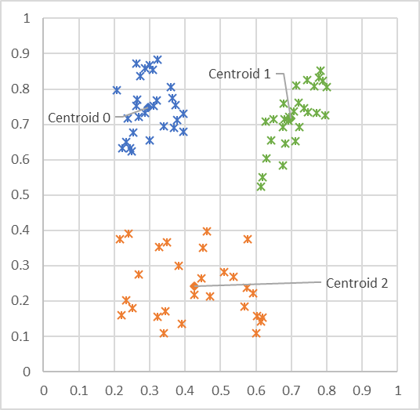
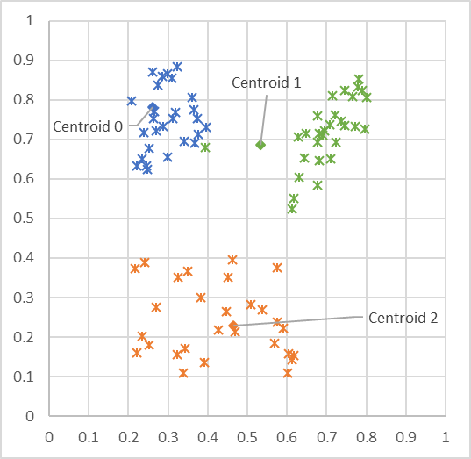
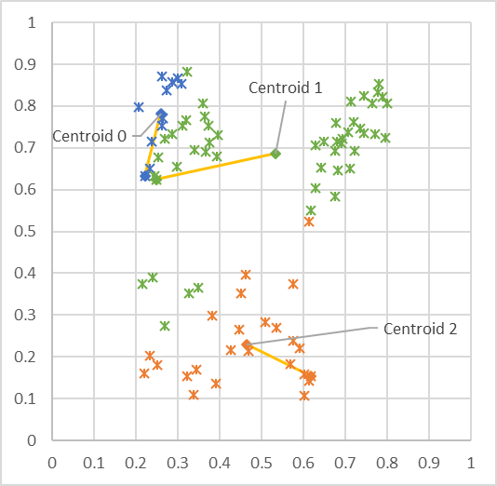
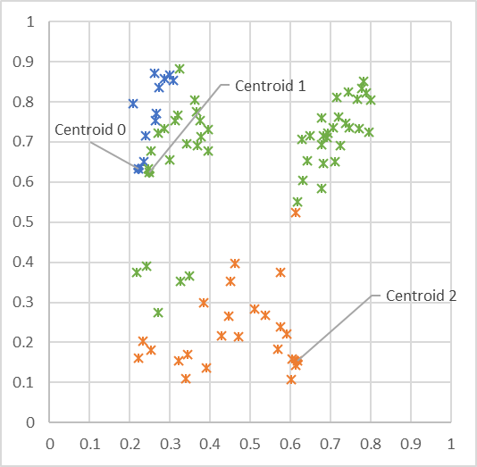
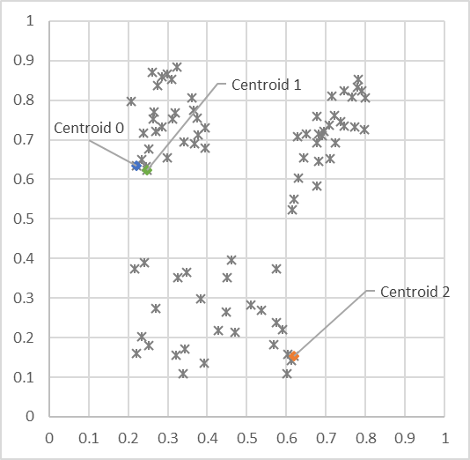
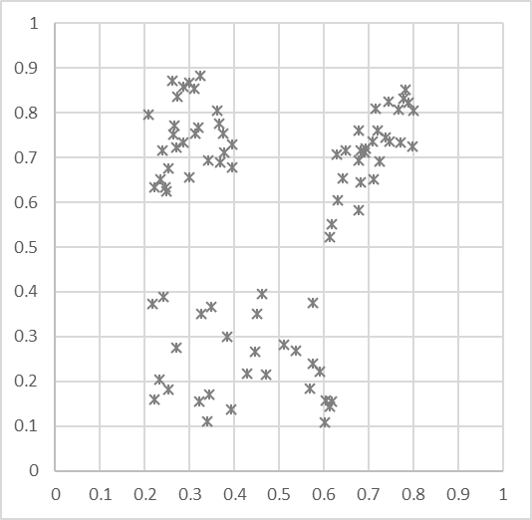

Visualizing K-Means
Unlabled Data
Initialize centroids to random data point locations
Each point assigned to nearest centroid
Update centroid locations to avg of assigned points
Each point assigned to nearest centroid
Update centroid locations to avg of assigned points
Each point assigned to nearest centroid
Converge!

Slide 10
Using K-Means
Pick a K based on your understanding of the domain
Run K-Means
Examine samples from each cluster
Adapt K based on what you find
If single clusters contain different entities, increase K
If entities spread across clusters, decrease K

Slide 11
Dimensionality Reduction
24x24 intensity array -> 576 features (dimensions)
Any individual dimension not very useful to the task
intensity of a single pixel?
Can we find more meaningful dimensions?
Represent the core of what is going on in the data
Might not capture all the fine details
More useful as input to machine learning algorithms

Slide 12
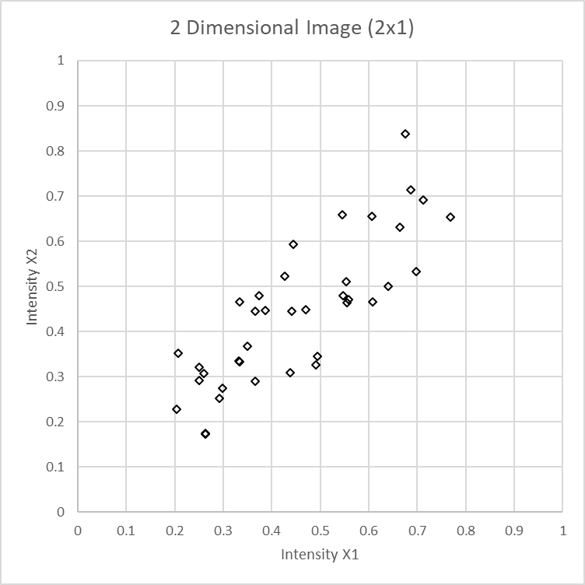
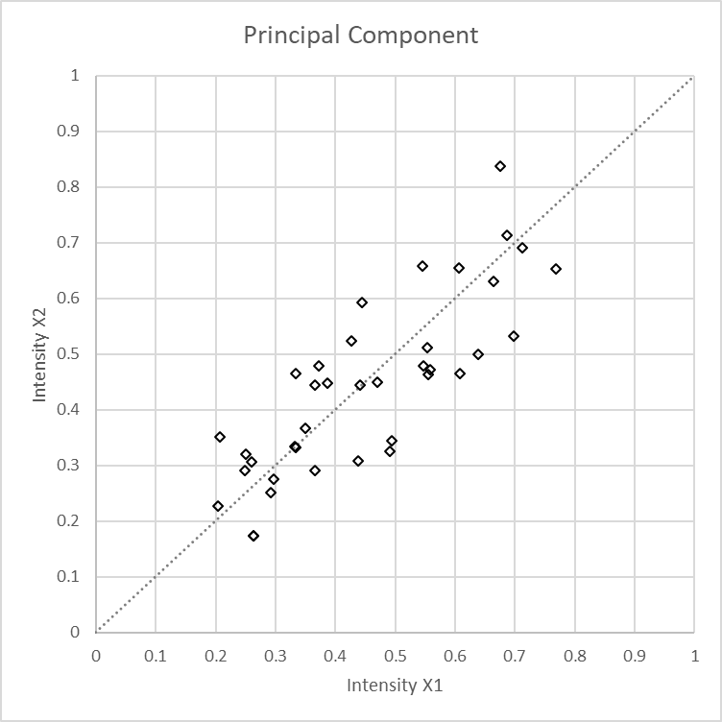
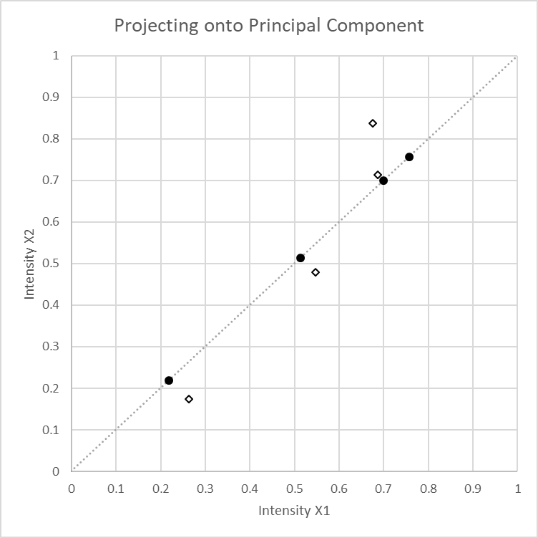
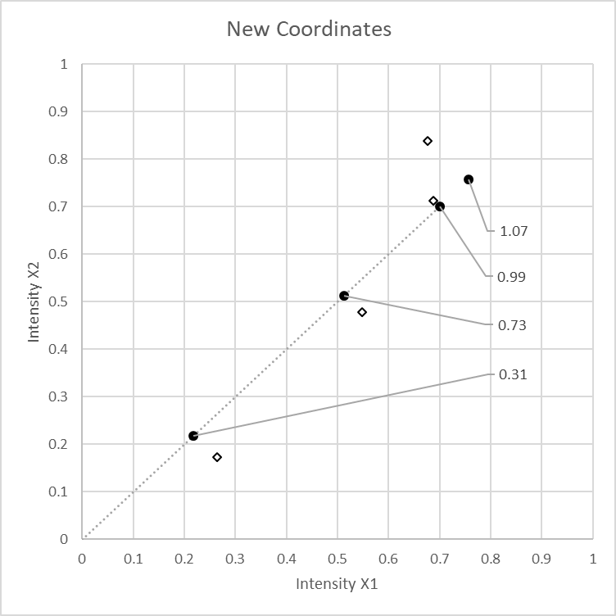
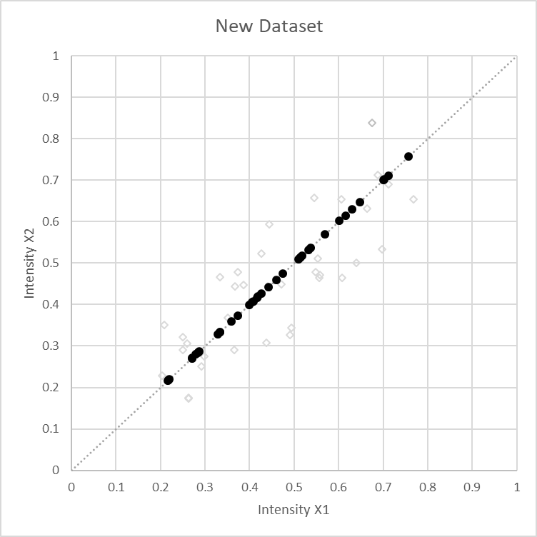
Principal Component Analysis (PCA)
Compress data, losing some detail
Can be repeated on remaining dimensions

Slide 13
Principal Components of our Blink Data
Component 1
Component 2
Component 3
Component 4
Component 5
Component 6
Component 7
Component 8
Component 9
Component 10

Slide 14
Using PCA for Dimensionality Reduction
Using 1
Using 10
Using 50
Using 100
Original

Slide 15
Computing PCA (the easy way)
(xTrain, xTest) = Assignment5Support.Featurize(xTrainRaw, xTestRaw, includeGradients=False, includeRawPixels=True)
# >>> len(xTrain[0])
# 576
from sklearn.decomposition import PCA
pca = PCA(n_components=10)
pca.fit(xTrain)
xTrainTransform = pca.transform(xTrain)
# >>> len(xTrainTransform)
# 3634
# >>> len(xTrainTransform[0])
# 10
# to reconstruct from 10 components to original number of dimensions
xTrainRestore = pca.inverse_transform(xTrainTransform)

Slide 16
Instance Based Learning
Classification technique that uses data as the model
K-Nearest Neighbors – K-NN
Model: the training data
Loss: there isn’t any
Optimization: there isn’t any
To apply, find the K nearest training data point to the test sample
Classify: predict the most common class among them
Probability: predict the distribution of their classes

Slide 17
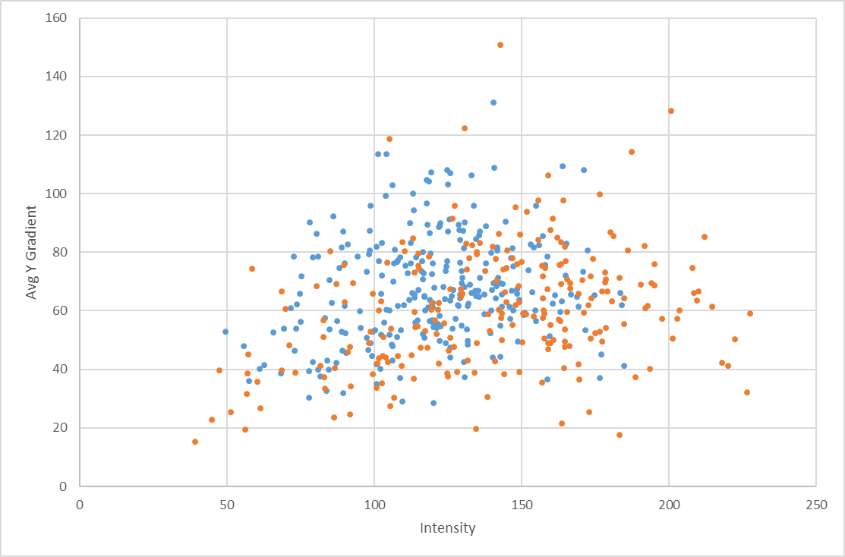
Example of K-NN

Slide 18
KNN Pseudo Code
def predict(xTest):
# for every sample in training set
# compute the distance to xText (using l2 norm)
# find the y values of k closest training samples
# return most common y among these values
# or the % that are 1 for a score…
Simple to train
Model can be large
Predict time can be slow

Slide 19
Summary
Clustering – Useful to find structure in your data when you have no labels
PCA – Useful to simplify your data, compress dimensions (but lose detail)
Instance Based Learning – Very simple learning method that uses training data as the model

